Slide 1
Buzzwords from Oracle Code One - 2019
GraalVM
Quarkus/Micronaut/Helidon
Evolution of Server Side Java – Java EE to Jakarta EE
Microprofile
Cloud Native Architectures with Service Mesh
JDK Features overview – Versions - 9,10,11,12,13
Contributing to Opensource

Slide 2

Graal VM – What is it ?
Universal
Virtual
Machine
Start your programs
Blazing fast
Written in
Java and is Opensource
Very low memory foot print
Polyglot VM that can run
Java, Javascript, Python, Ruby, R , Scala, Kotlin etc
Native Image builder

Slide 3
Graal VM – How does it work ?
Traditional JIT compilation at a high-level
Java Hello
Javac Hello.java
Byte Code Interpreter
JIT Compiler
Hello.class ( Byte Code )
Native Machine Code
Compile Time
Run time

Slide 4
Graal VM – How does it work ?
Graal Compilation at a high-level
Javac Hello.java
Java –XX AOTLibrary=Hello
Byte Code Interpreter
Hello.class ( Byte Code )
JIT Compiler
Jaotc Hello.class
( AOT compilation )
Execute Native Machine Code
Compile Time
Run time

Slide 5
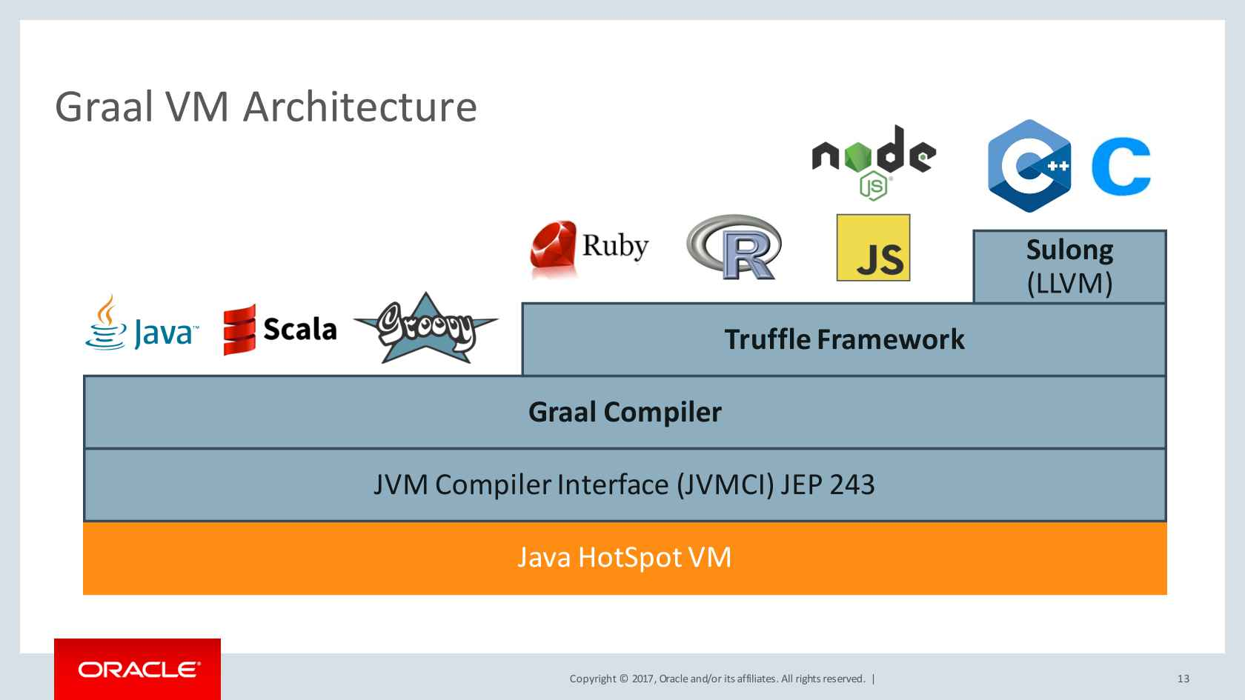
Graal VM – Architecture

Slide 6

Graal VM – Demo Hello World

Slide 7



Quarkus/Micronaut/Helidon – What are they ?
Light weight Frame works
Built to apply the benefits of GraalVM
Helidon is Oracle’s and Quarkus is Redhat’s. Micronaut is kind of independent
All these projects are intended for micro service development using light weight specification from microprofile and EE8 .
Anything extra can be added or configured to the project using extensions

Slide 8
How do they Work ??
Do all the hard work at build time
Minimize the amount of Metaspace needed for JIT compilation
Use Native-Image from Graal-VM to build on top of what is already pre-compiled and optimized

Slide 9
Quarkus/Micronaut/Helidon – Startup Time graph
Native Image
10.5ms
Quarkus
JDK 8
983ms
30ms
Micronaut
1967ms
Helidon
25ms
979ms
500ms
1000ms
1500ms
2000ms

Slide 10
Quarkus/Micronaut/Helidon – Memory Footprint graph
Native Image
16MB
Quarkus
JDK 8
160MB
37MB
Micronaut
198MB
Helidon
26MB
107MB
50MB
100MB
150MB
200MB

Slide 11
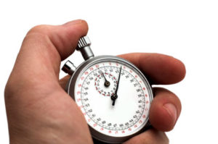
Quarkus/Micronaut/Helidon – Why care about startup and memory footprint
Low compute costs that can be saved on Memory and CPU
Low Down time
During the scaling process
Startup time is very important when applications autoscale in large numbers

Slide 12
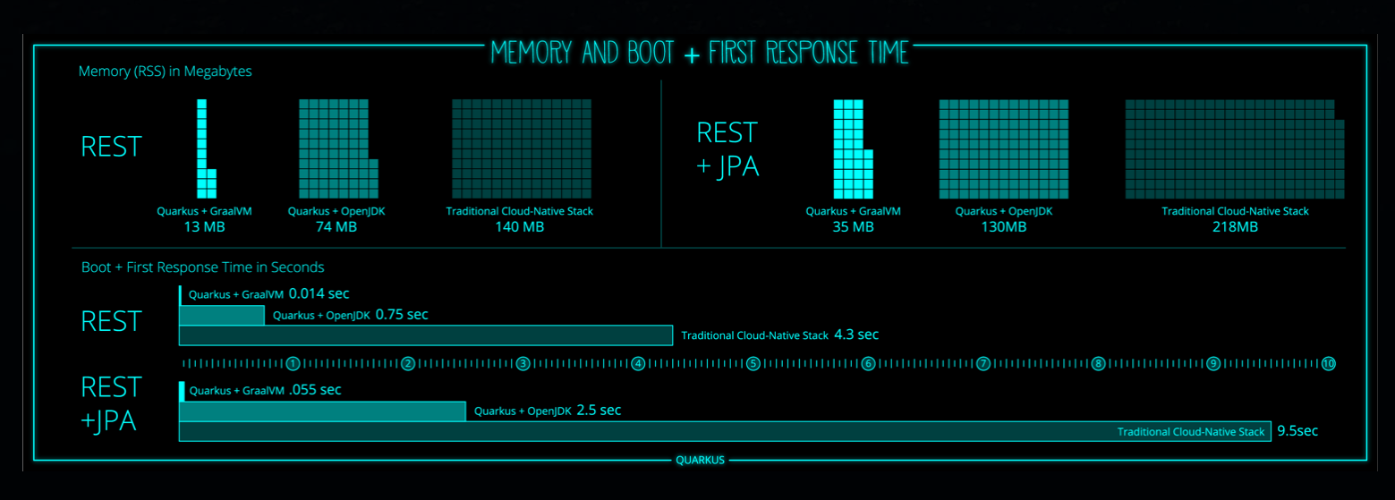
Quarkus – Supersonic Subatomic Java from Redhat

Slide 13
Quarkus/Micronaut/Helidon - Challenges for adoption
Not Supported
OK with Caveats
Dynamic Class loading
InvokeDynamic & method handles
Reflection Implementations
Reflection(Manual List)
Dynamic Proxy ( Manual list)
JNI ( manual list )
Static initializers ( eager )

Slide 14
Quarkus – Demo

Slide 15
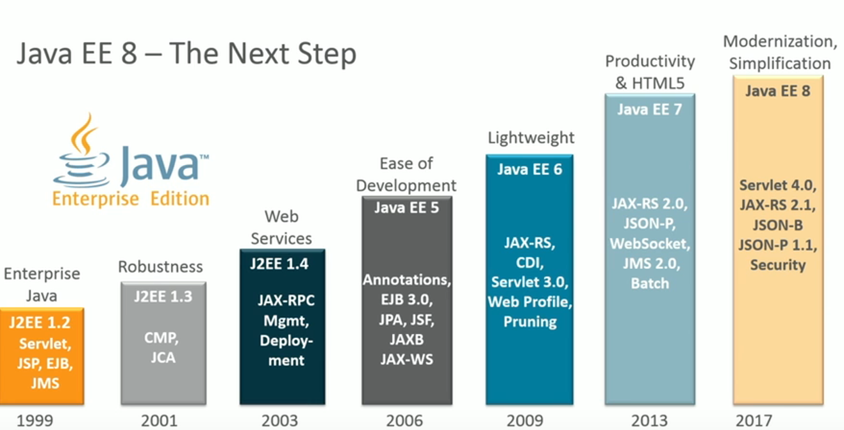
Evolution of Serverside Java – Java EE to JakartaEE

Slide 16



Evolution of Serverside Java – Java EE to JakartaEE
Java EE 8 is transferred to Eclipse foundation
from Oracle JCP in 2017 as EE4J project,
which now is called Jakarta EE 8 ( Released Sep 2018 ).

Slide 17
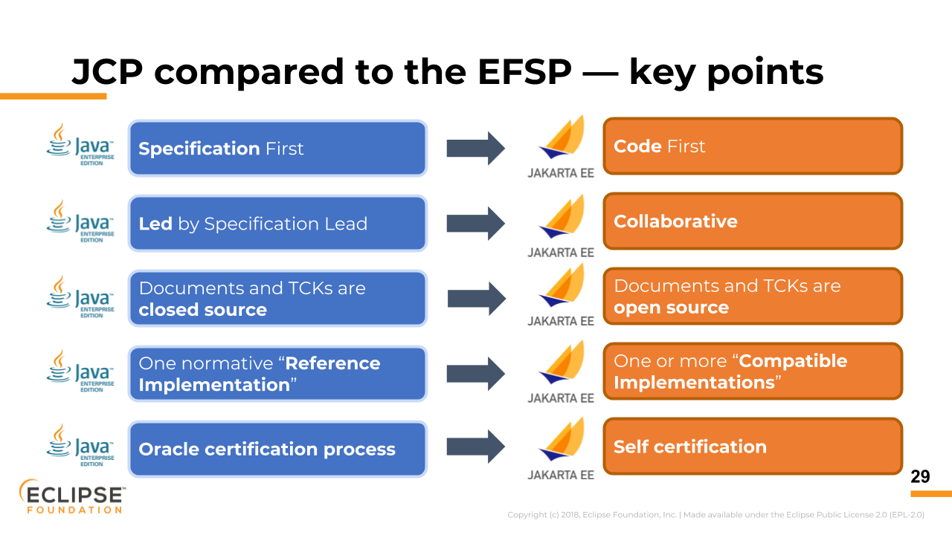
Evolution of Serverside Java – Java EE to JakartaEE

Slide 18

Microprofile
Implements light weight specs which are needed for Modern cloud native apps.
Major vendors contribute toward microprofile and have their own implementations
IBM Open Liberty
Payara Micro
Apache TomEE
Redhat Thorntail ( will now be transferring to Quarkus)
It includes a subset of Java EE specs and also some new specs needed for cloud native apps.

Slide 19
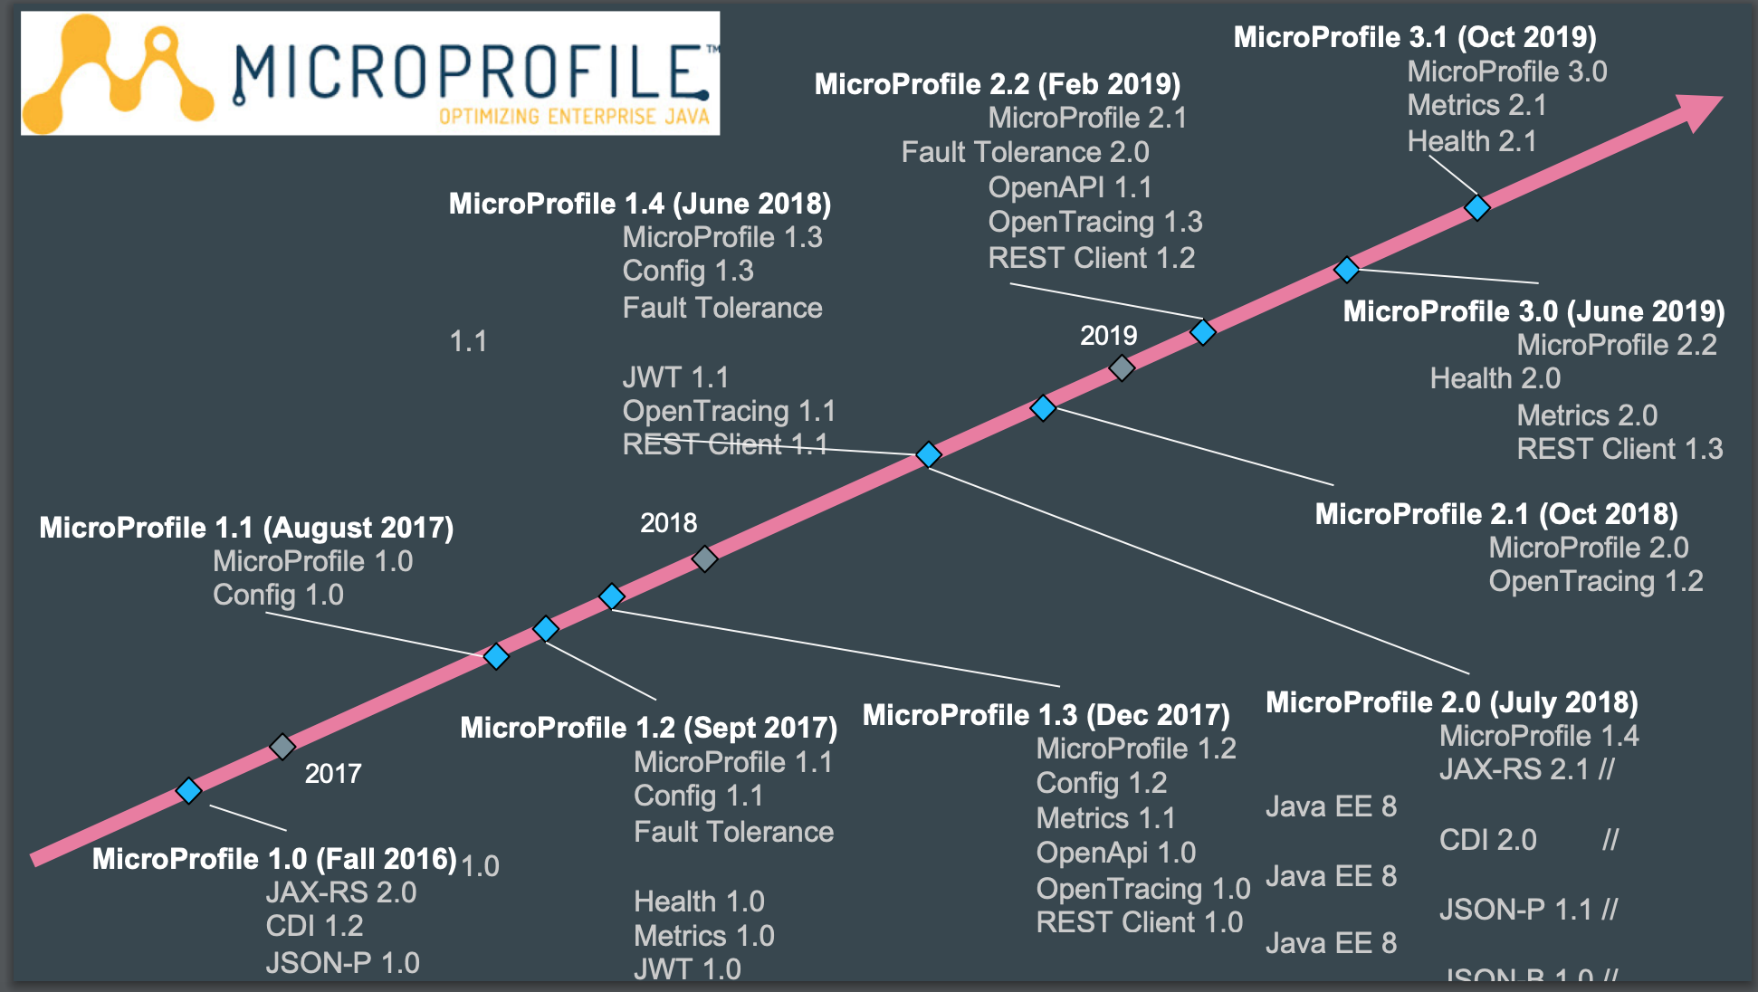
Microprofile – Roadmap

Slide 20
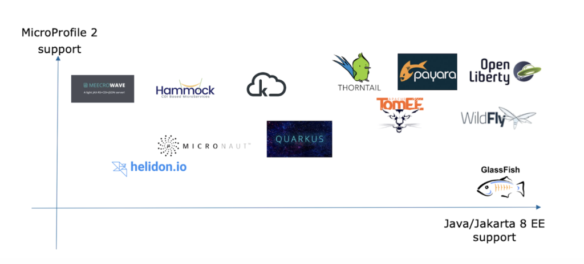
Microprofile and JakartaEE support Graph

Slide 21
Microprofile – Quarkus Cheat Sheet
MicroProfile Specification | Quarkus Dependency ( Maven group:artifact )
CDI | io.quarkus:quarkus-arc
JAX-RS | io.quarkus:quarkus-resteasy
JSON-P | io.quarkus:quarkus-jsonp
JSON-B | io.quarkus:quarkus-jsonb
Config | N/A. Included by default
Rest Client | io.quarkus:quarkus-smallrye-rest-client
Fault Tolerance | io.quarkus:quarkus-smallrye-fault-tolerance
Health Check | io.quarkus:quarkus-smallrye-health
Metrics | io.quarkus:quarkus-smallrye-metrics
JWT Security | io.quarkus:quarkus-smallrye-jwt
OpenAPI | io.quarkus:quarkus-smallrye-openapi
OpenTracing | io.quarkus:quarkus-smallrye-opentracing
Reactive Streams Operators | io.quarkus:quarkus-smallrye-reactive-streams-operators
Reactive Messaging (Draft) | io.quarkus:quarkus-smallrye-reactive-messaging

Slide 22
Miproprofile - Demo

Slide 23
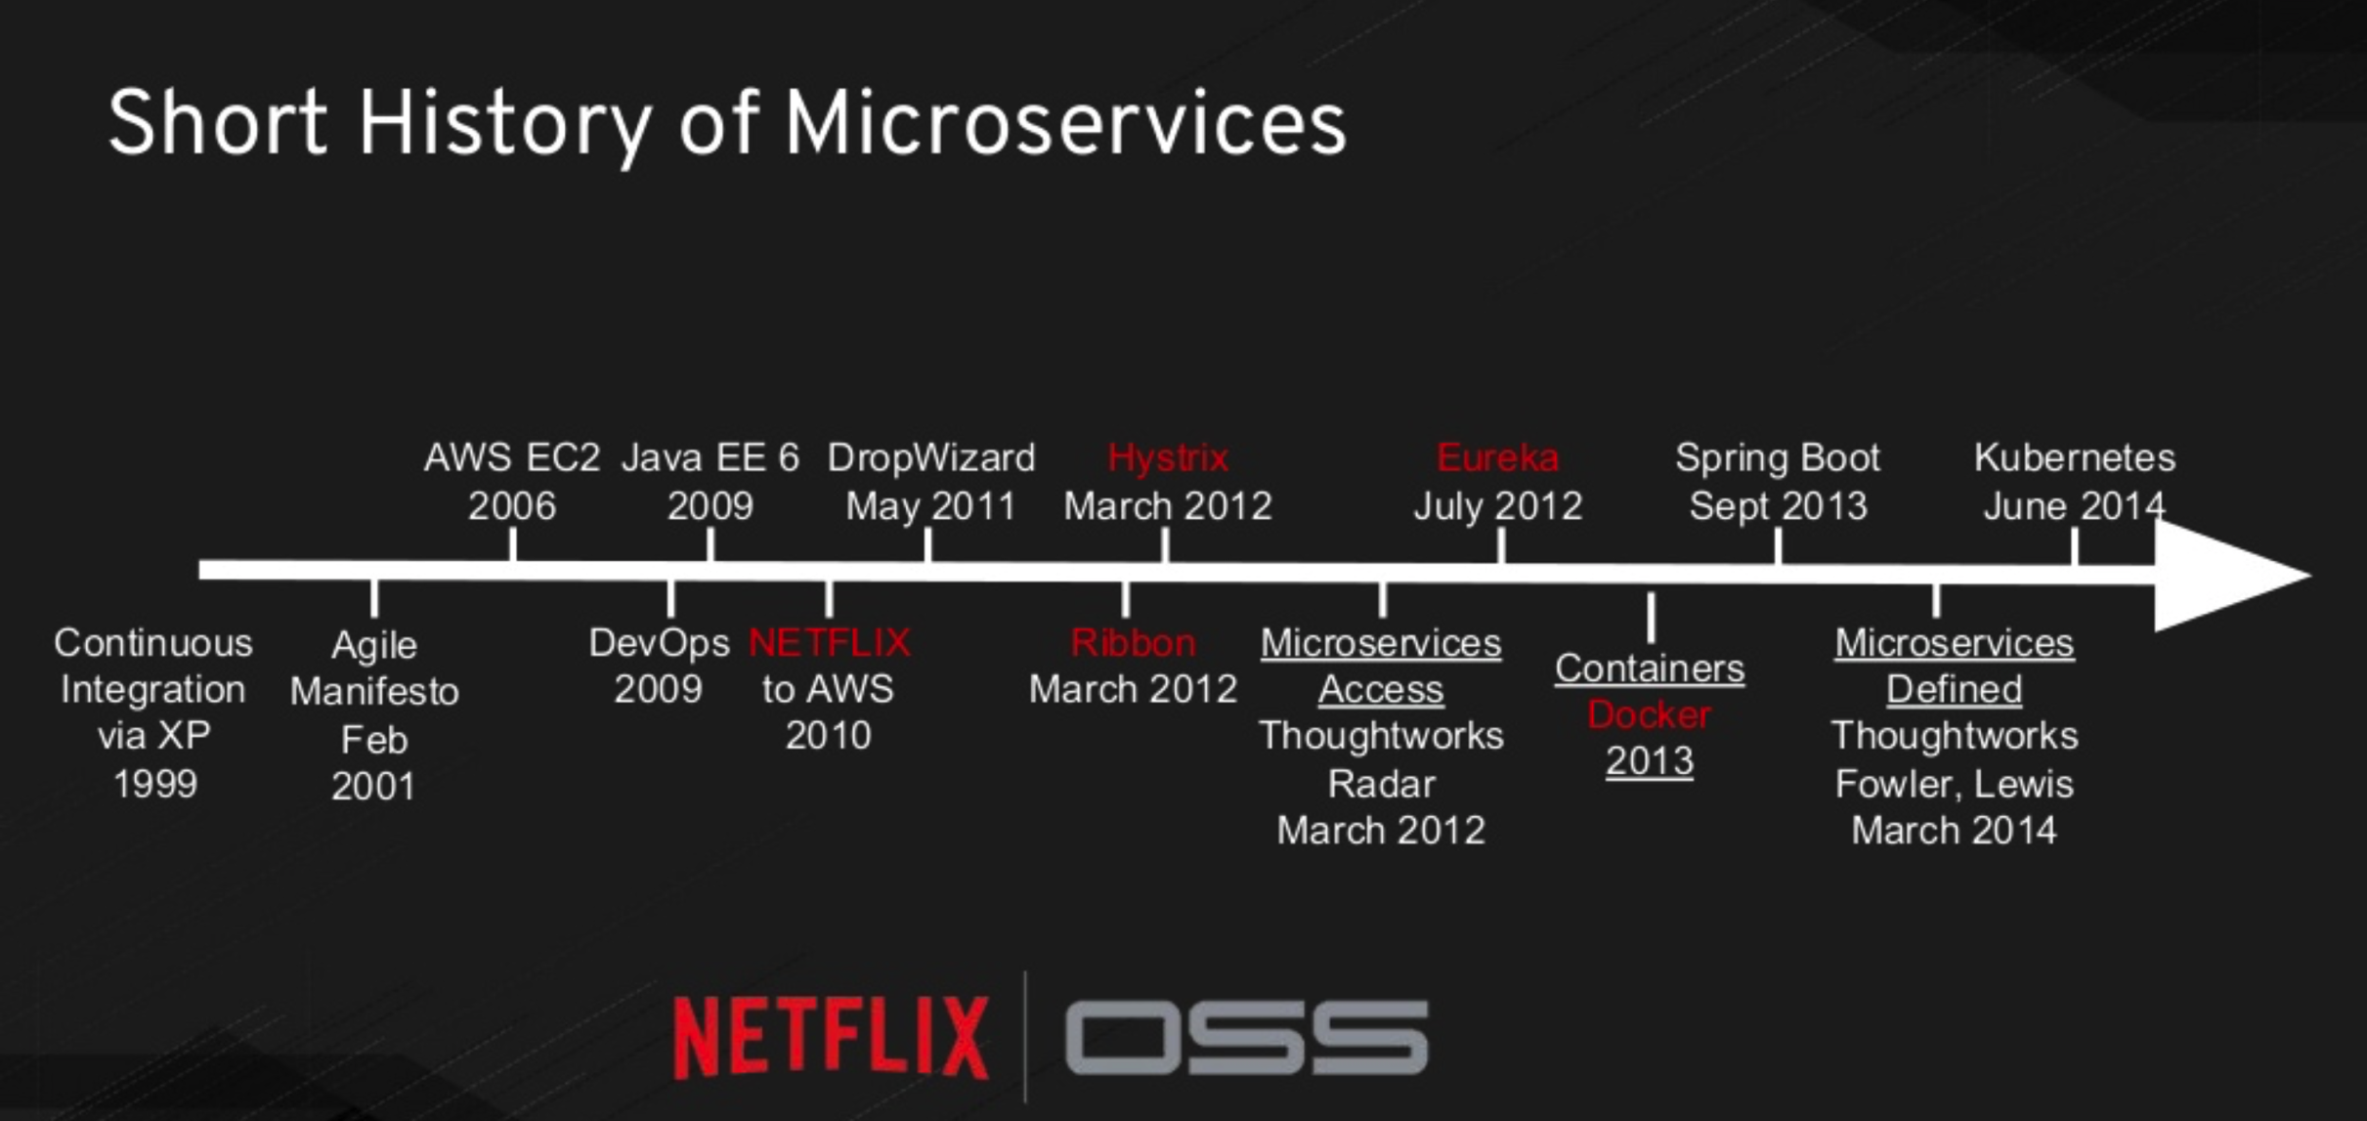
Cloud Native Architectures with Service Mesh-
Brief History of Microservices

Slide 24
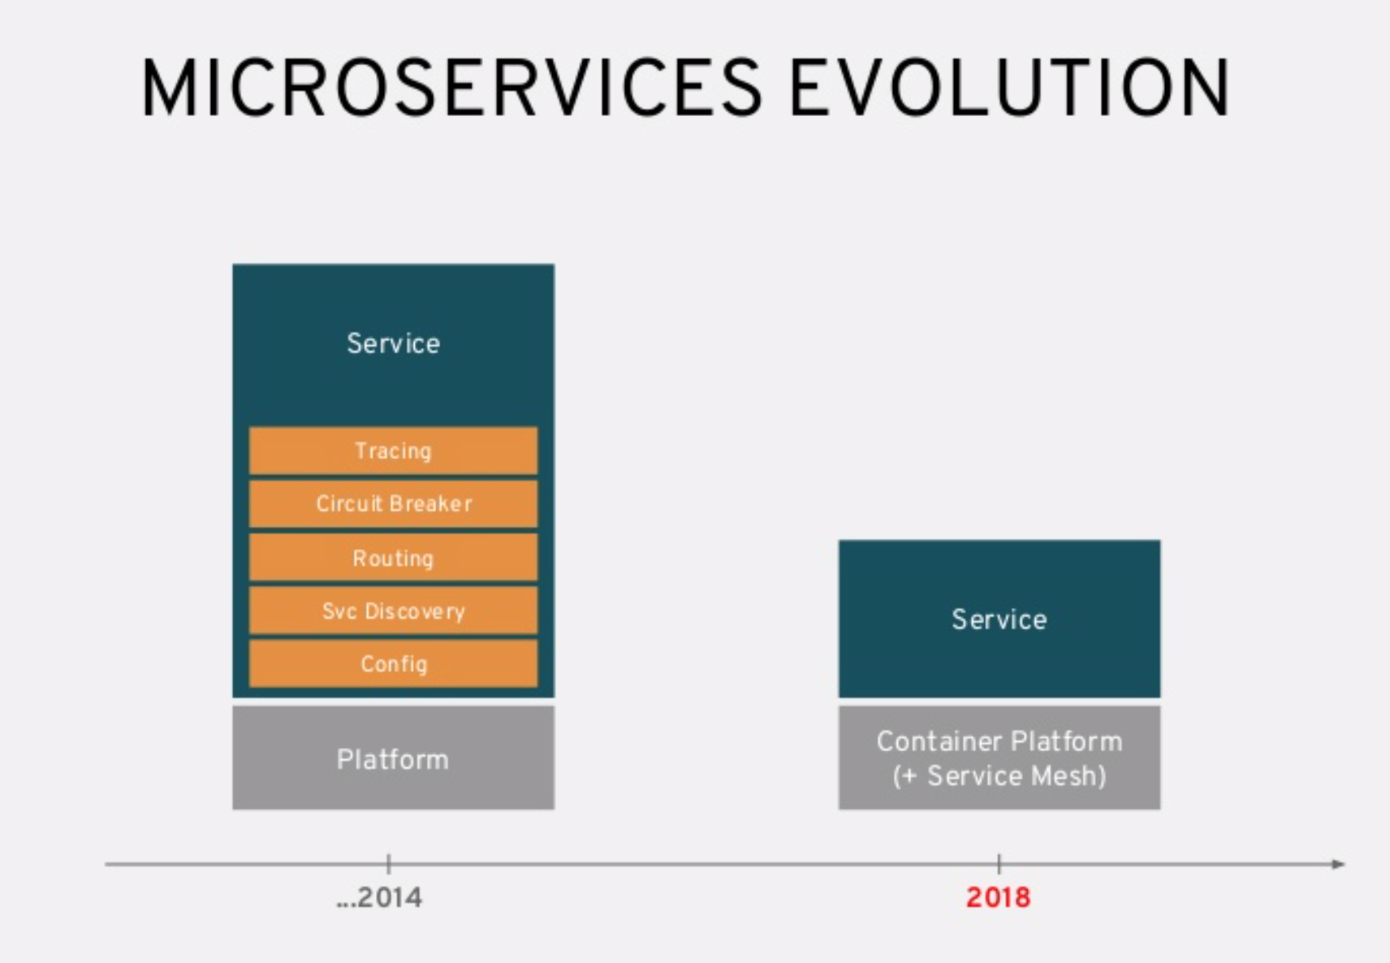
Cloud Native Architectures with Service Mesh-
Microservices Evolution from 2014 to 2018

Slide 25
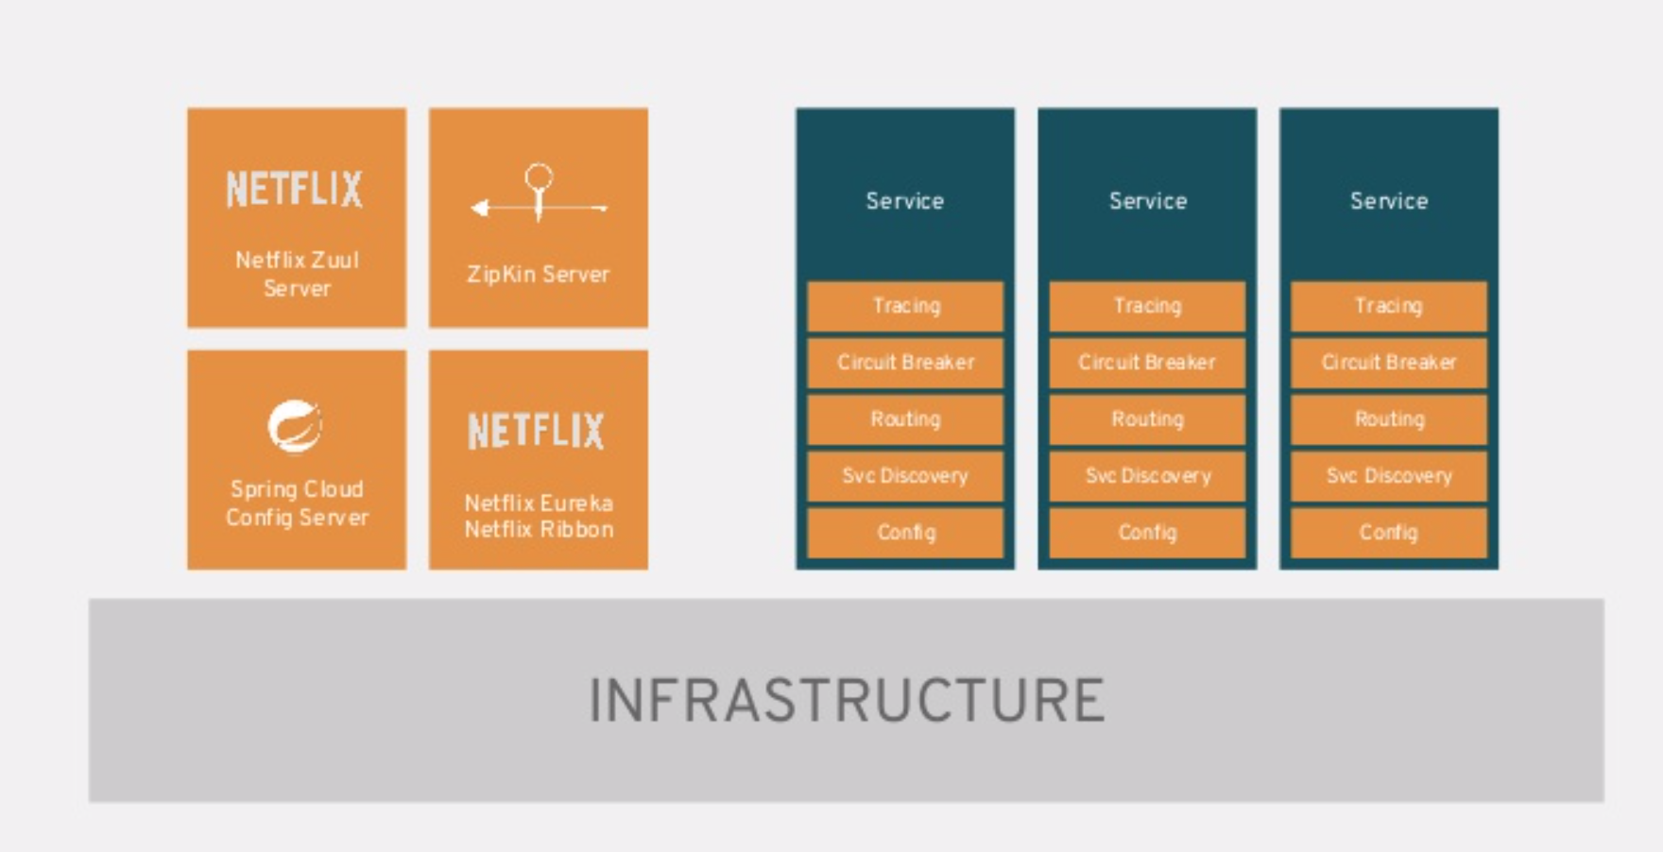
Cloud Native Architectures with Service Mesh
- Netflix OSS Architecture

Slide 26
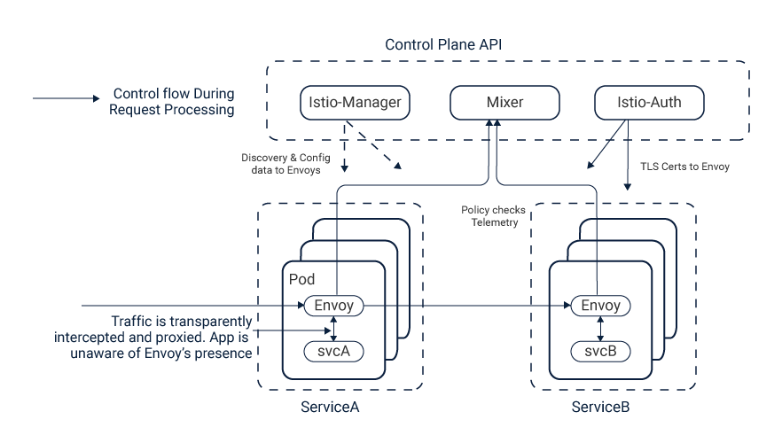
Cloud Native Architectures with Service Mesh
- ISTIO Architecture

Slide 27
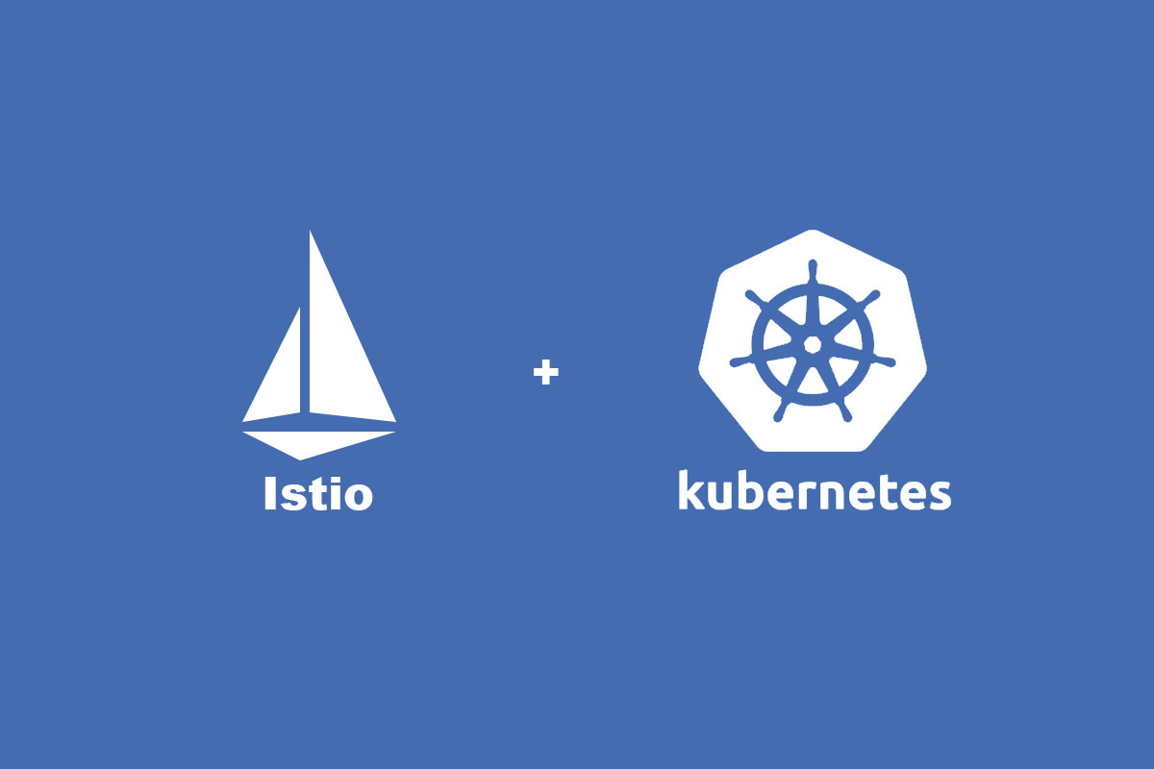
Cloud Native Architectures with Service Mesh
- ISTIO
Traffic Management
(Routing/loadbalancing)
Policies and Security
(Authorization/Authentication for Service to Service communication)
Performance and Scalability
(monitoring and sending telemetry and performance details )
Observability
( Service Discovery and Circuit breaking features )
Deployment Models

Slide 28
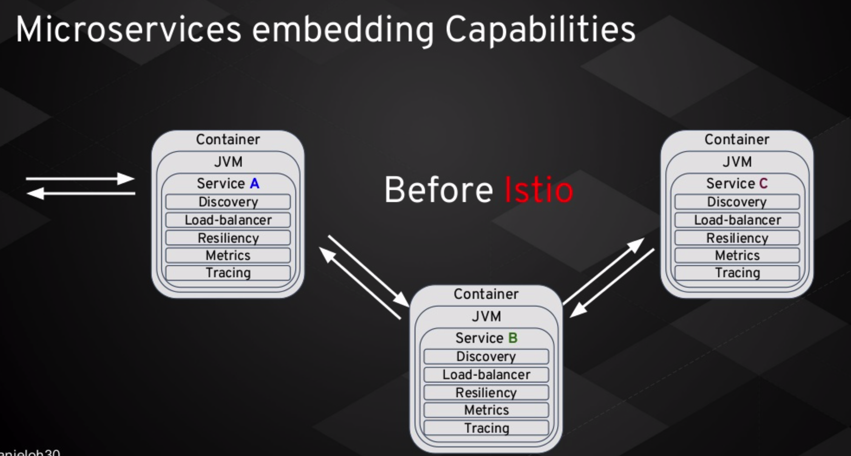
Cloud Native Architectures with Service Mesh
- Before ISTIO

Slide 29
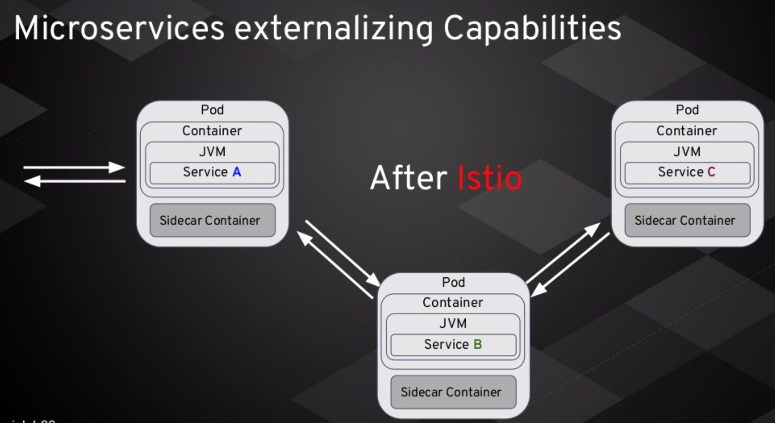
Cloud Native Architectures with Service Mesh
- After ISTIO

Slide 30
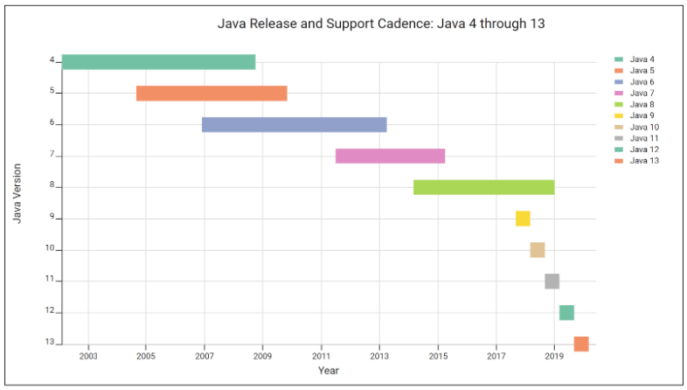
JDK Features overview – Versions - 9,10,11,12,13

Slide 31

Contributing to Open source - Why Contribute ??
Opportunity to get Involved in the Community
Opportunity to get recognized in global forums for any great work you do for community
Improve you software skills and engineering processes from different oragnizations
Experience working with distributed teams spread across globe.
meet new people
from different industries and different skill sets
Business Opportunity for your work.

Slide 32
Contributing to Open source – What to contribute ??
Documentation
Website fixes
Code tests
Code examples
Coverage increase for unit, integration, performance and static tests
New features
Dependencies updates
Workshops

Slide 33
Contributing to Open source – How to contribute ??
Source Code Repositories – GitHub Forking work flow
JIRA and Bugzilla
Project Mailing lists
Dev discussion Groups (Google groups/Yahoo groups )
Instant Messaging/Chat ( Gitter , Slack, etc )
Video Communications ( Google hangouts, Zoom, skype etc )

Slide 34


